Slide 1
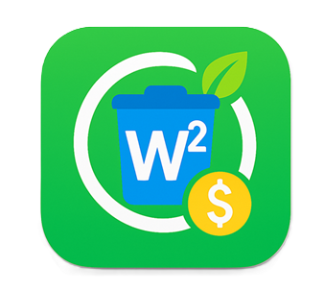
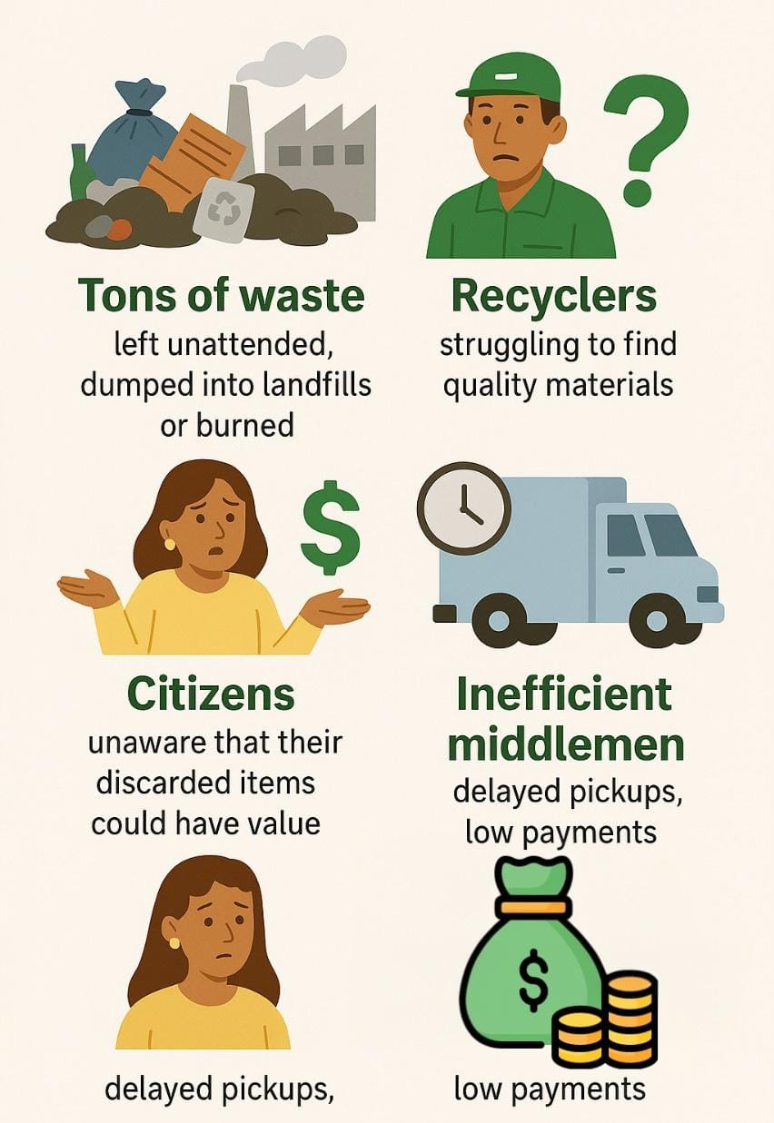

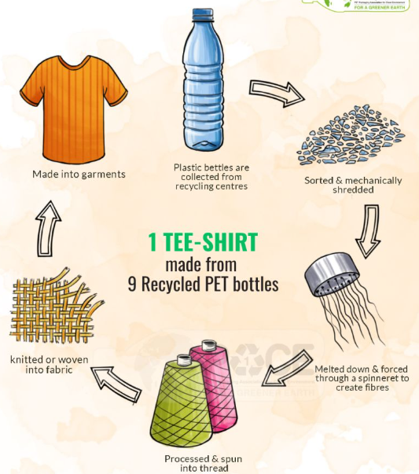
DANUSH VIKRAMAN G B 4th Year B-Tech CSE M TEHJO NITHYA SHREE 4th Tear B-Tech ECE
TRIWIZARDATHON
MAGE SLAYERS
W² (Waste 2 Worth) TURN YOUR TRASH INTO CASH
DRAWBACKS IN THE EXISTING PROJECTS
The existing waste management projects suffer from inefficiencies due to fragmented manual operations, absence of standardized pricing, unreliable collection services, and a lack of transparency in tracking waste sources and volumes.
PROBLEM STATEMENT
Lack of awareness and accessibility in waste management leads to valuable recyclable materials being discarded, causing environmental harm and resource scarcity.
FOR SELLERS (WASTE GENERATORS) Recycle your waste worry-free — it could be plastic, metal, e-waste, or paper — and earn money per kilogram, depending on the item and its worth
NEED OF THE HOUR
W² is a smart, data-driven platform that bridges the gap between waste producers and recyclers by streamlining collection, enabling transparent transactions, and unlocking the hidden value of waste — transforming sustainability into an accessible, rewarding, and seamless experience for all.
FOR RECYCLERS/BUYERS (BUSINESSES) You can simply surf through waste listings, bid against other bidders in real-time or purchase material in bulk — all at the click of a button.
In future we’re planning to combine the recycling part of the thrash after collection

Slide 2
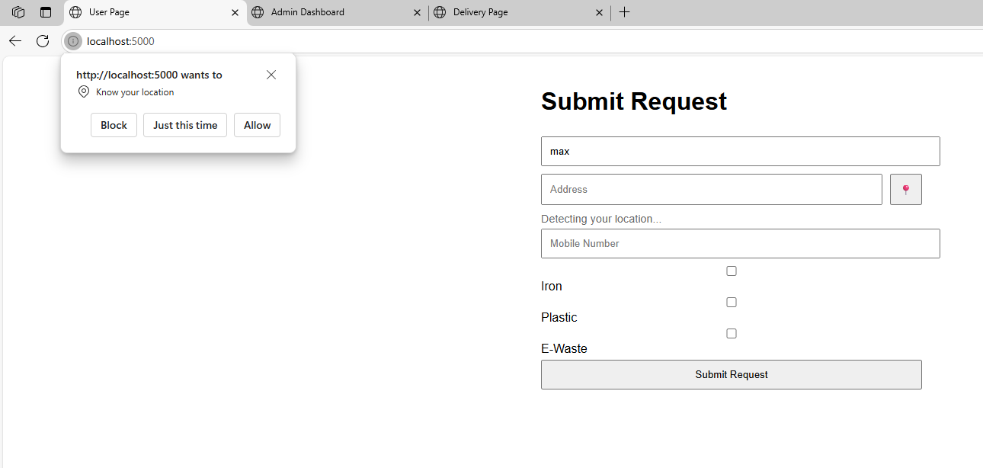
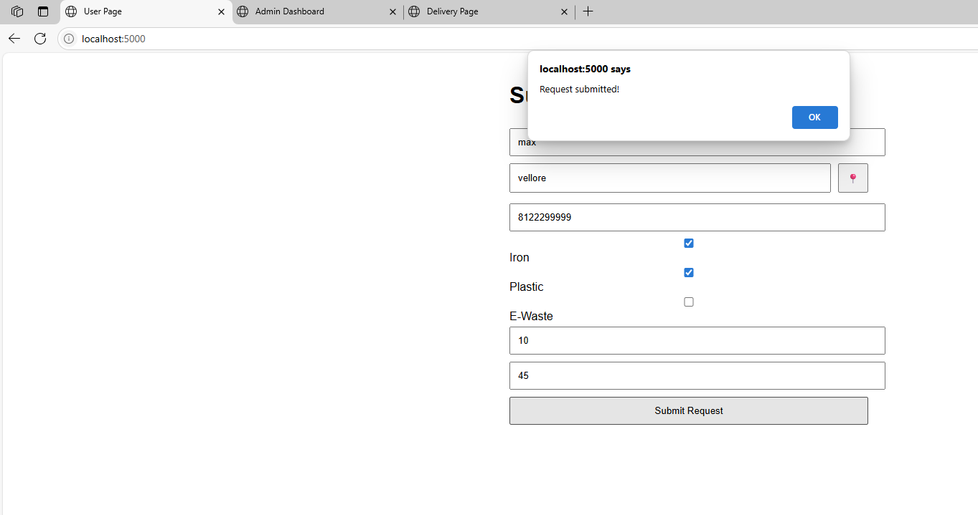
LOGIN/SIGN UP PAGE:
Once entered our W², our partner will be welcomed through our login/sign up page.
After successful login we will direct our partner to the home page.
HOME PAGE:
Here we get the information regarding:
Location of our partner
Items to be disposed (using a checkbox), along with approximate quantity in Kg.
Using this information, we will assign the task to our nearby pickup helper.
The approximate weight information helps us to estimate the amount of money to be handed over to our partner while picking up the thrash.
Then the confirmation message is displayed on the screen.
Once our pickup helper reaches our warehouse, a notification is given. (helps our environment-friendly partner to stay satisfied after knowing that they have not caused any harm to our motherland –EARTH! by being a responsible citizen.)

Slide 3
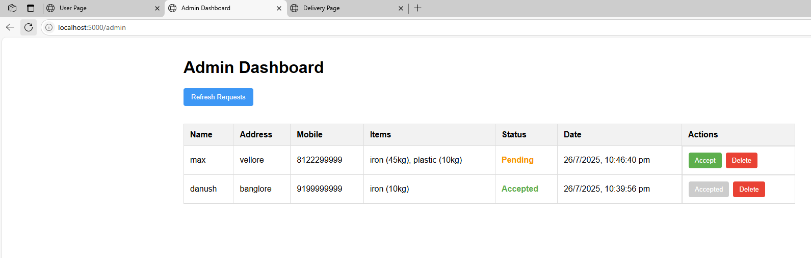
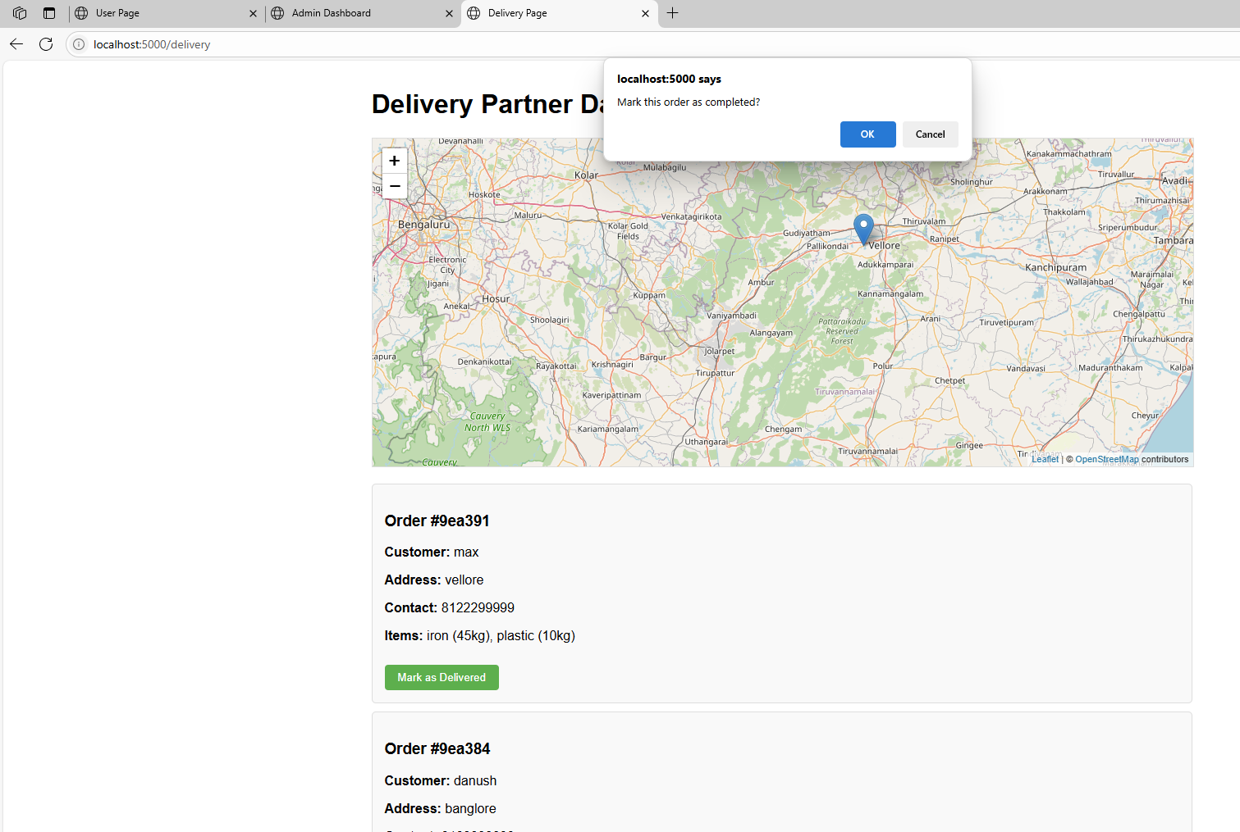
ADMIN:
The admin has the following information and accesses:
Can view all the requests, including every details.
Can manage the requests (reject, change pickup helper assignment, change location, change the price per Kg, etc.)
Pickup helper assignment
Get the information regarding the pickup helper reaching the warehouse, along with the warehouse location and time of delivery at warehouse.
Details regarding payments
PICKUP HELPER:
The pickup helper gets the following details and accesses:
Location of the pickup
Name of our partner
Weight of the thrash
Can contact our partner through us (provision of masked phone number)
Can update pickup status
Once the goods are reached to the warehouse, the admin pays the money to our partner.

